Slide 1
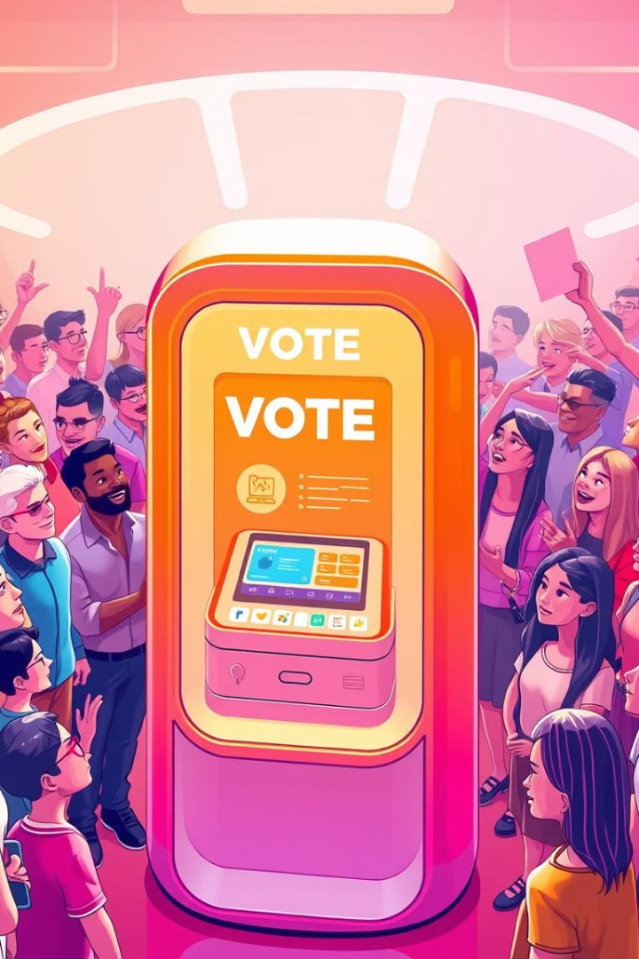
BLOCKCHAIN BASED VOTING SYSTEM:
Blockchain technology offers a secure and transparent solution for modernizing the voting process. By leveraging decentralized ledgers, the system aims to enhance trust, accessibility, and efficiency in democratic elections.

Slide 2
PRESENTATION OUTLINE :
INTRODUCTION
OBJECTIVES
DRAWBACKS OF EXISTING WORK
PROBLEM DEFINITION
PROPOSED METHODOLOGY
CONCLUTION

Slide 3
Introduction
The rapid advancements in technology have transformed the way societies function, leading to innovative solutions for age-old problems. One such problem is ensuring secure, transparent, and efficient voting in democratic systems. Traditional voting methods, whether paper-based or electronic, often face challenges such as voter fraud, tampering, high costs, and lack of transparency. As the demand for secure and trustworthy voting mechanisms grows, blockchain technology emerges as a revolutionary solution, paving the way for a modern voting system suited for the digital age.

Slide 4
A Modern Voting System for the Digital Age is designed to address these issues by providing a secure, transparent, and immutable platform for conducting elections. By leveraging blockchain, this system ensures that votes are safely recorded, cannot be altered, and remain anonymous, while still allowing for real-time verification by voters. This modern approach to voting promises to enhance electoral transparency, trust, and create a more robust and reliable voting mechanism for the future.

Slide 5

Drawbacks of Existing Work
1
Voter Fraud and Manipulation
2
Lack of Transparency
Issues like double voting, voter impersonation, and manipulation of vote counts are recurring problems in many elections.
In traditional voting systems, there is often no way for voters to verify that their votes were recorded correctly or included in the final tally.
3
Limited Accessibility
Traditional voting methods, particularly in-person voting, can be inaccessible to people with disabilities, those living in remote areas, or citizens living abroad..

Slide 6
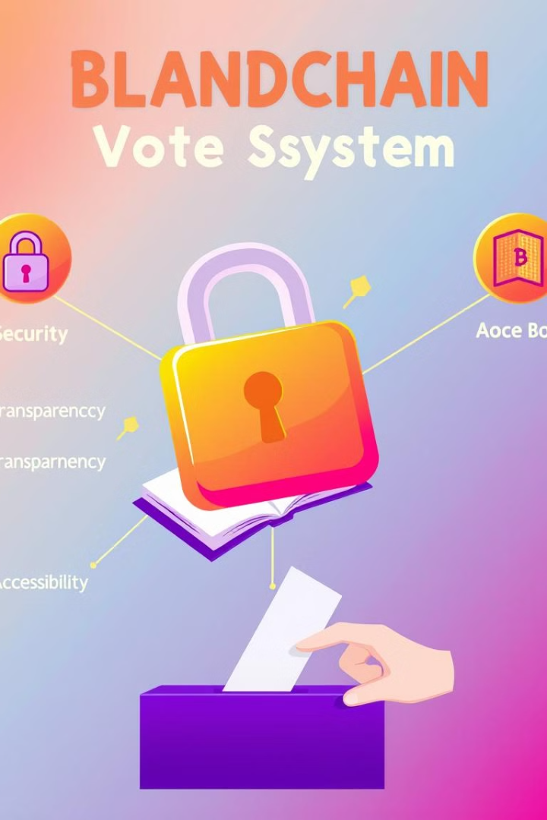
Objectives
Secure and Transparent
Accessible and User-Friendly
Blockchain Based voting system aims to ensure the integrity and auditability of the voting process through cryptographic techniques.
The system should be designed to be easily accessible and intuitive for voters, regardless of their technical expertise.
Scalable and Efficient
Widespread Adoption
The system should be capable of handling large-scale elections while maintaining low latency and high throughput.
The goal is to create a blockchain voting solution that can be widely adopted and integrated into real-world electoral processes.

Slide 7
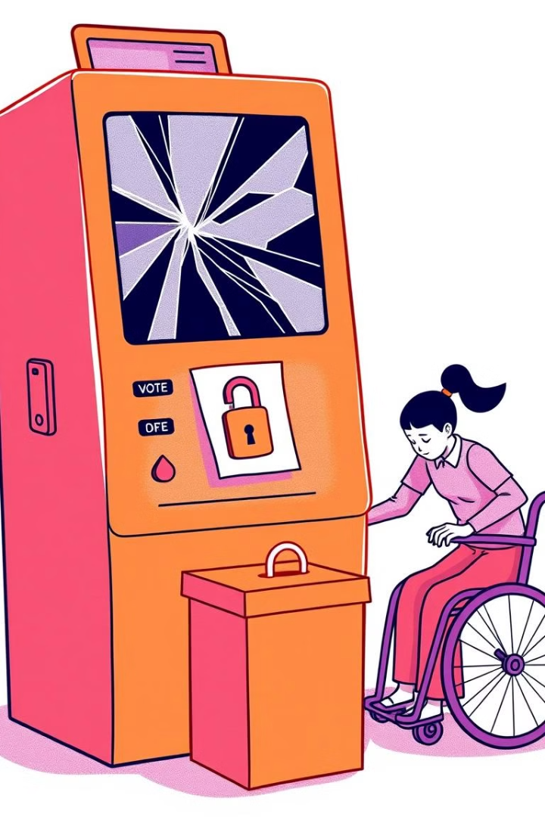



Problem Definition
Lack of Trust
Voters often express concerns about the security and transparency of traditional voting systems, undermining confidence in the electoral process.
Accessibility Barriers
Existing voting methods can be inaccessible or inconvenient for certain demographics, such as the elderly, disabled, or those in remote areas.
Inefficient Processes
Outdated voting technologies and manual tallying processes can lead to delays, errors, and inefficiencies in the electoral process.

Slide 8
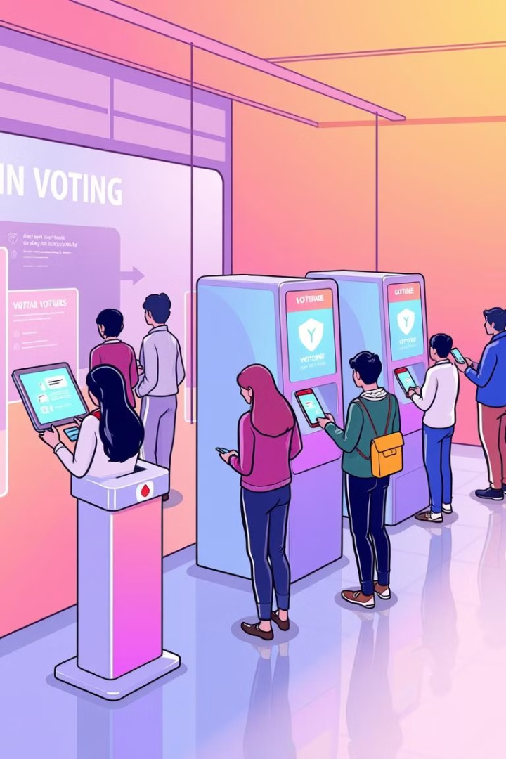
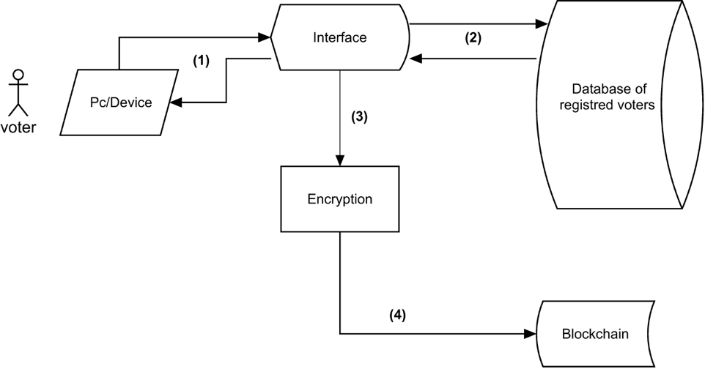
Proposed Methodology

Slide 9
Requirement Analysis
Technology Selection: Choose appropriate tools and frameworks such as:
Cryptographic algorithms (e.g., SHA-256)
Face recognition libraries (e.g., OpenCV, Dlib)
Voice interaction tools (e.g., Google Speech-to-Text API).
Modules Identification:
User Authentication Module: Face recognition and Aadhaar credential verification.
Voting Module: Interface for casting a vote.
Blockchain Module: Secure storage of votes with hashing algorithms.
Result Analysis Module: Analytical charts for real-time results.
Voice Command Module: Enable user navigation through voice interaction.

Slide 10
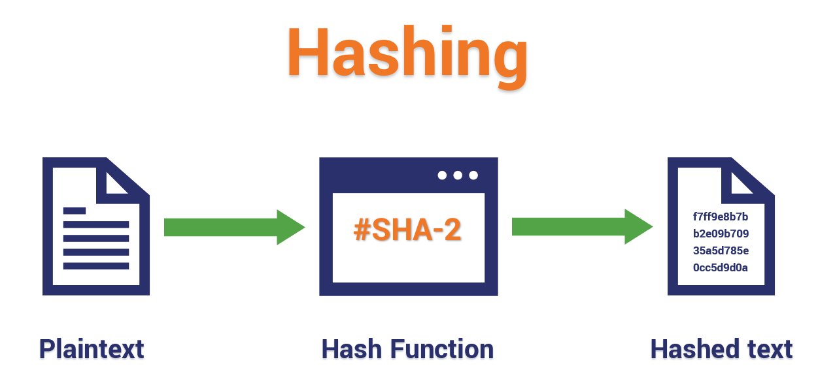
Algorithm:

Slide 11
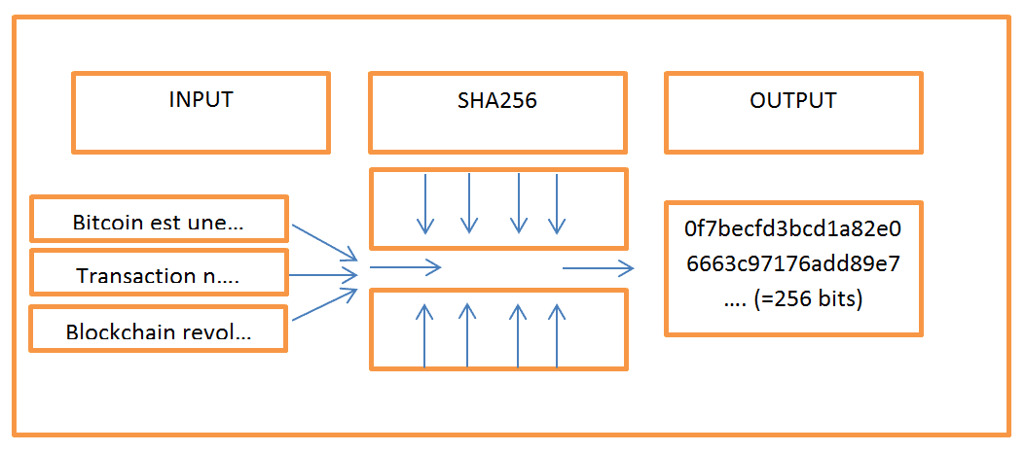

Slide 12
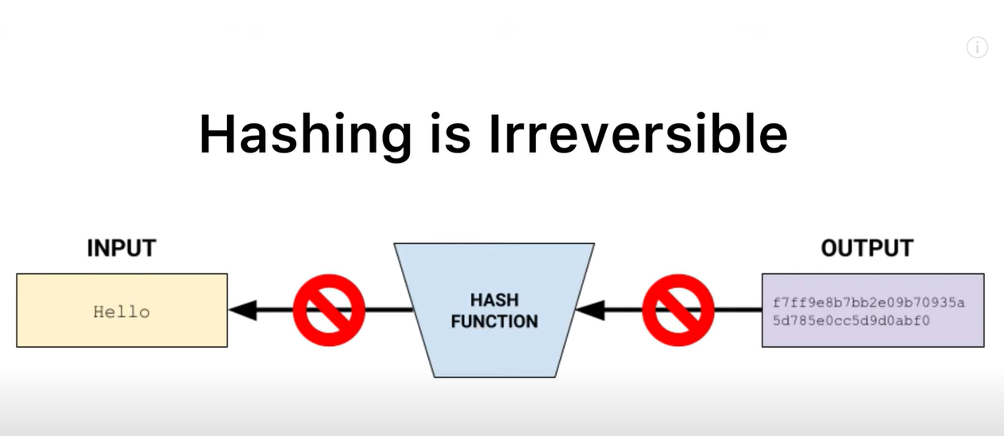

Slide 13
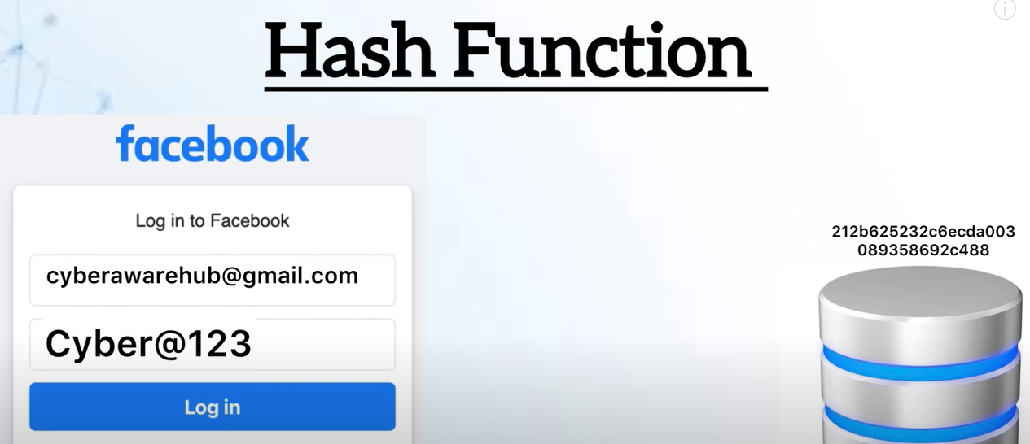
Example :

Slide 14
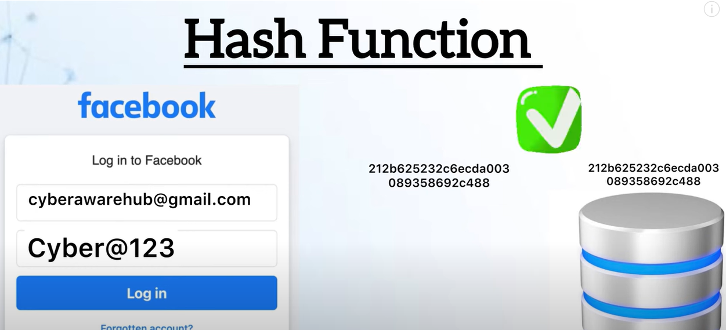

Slide 15

Conclusion and Key Benefits
1
Increased Trust
Blockchain Ballot's transparent and auditable voting records will help restore public confidence in the electoral process.
2
Enhanced Accessibility
Remote and mobile voting options will make the democratic process more inclusive and accessible to a wider range of voters.
3
Efficient Tallying
Automated vote counting and real-time result reporting will streamline the election process, reducing delays and errors.

Slide 16
Thank you

